Slide 1
Unified Modeling Language
UML

Slide 2
Object Oriented Programming Concepts
Object definition
Entity role defined in the system
Characterized by: status, behavior and identity
concrete/abstract
an action can be undertaken
can perform an action

Slide 3
Object Oriented Programming Concepts
Object state
The actual values of object’s properties at a certain moment in time
Object behavior
Shows the way in which an object reacts to events
Shall be submitted by means of operations that change its status

Slide 4
Object Oriented Programming Concepts
Operation
a simple action that an object a is running on another object to get an answer
Methods
all the operations an object can perform or be performed on that object, implemented in a p
Identity
all objects have identity
even if they have the same values of attributes, they denote are different objects

Slide 5
Object Oriented Programming Concepts
Classses
a set of objects with common structure and behavior
Objects are classes instances
Encapsulation
Operations forms the interface of a class
Through the interface, a class presents other classes its functionality without showing its structure
Hiding the details of implementation is called encapsulation:
Storage structure
Implementation of the operations (you do not know what and how)

Slide 6
Object Oriented Programming Concepts
Polymorphism
the same message to more than one class of objects, generates different responses with different meanings.

Slide 7
Object Oriented Programming Concepts
Types of operations
Constructor-creates a new instance of the object, a new object of the class
Destructor – destroys the object
Getters –Retrieval - do not alter the status of the article; retrieving attribute values
Setters - Update – alter the status of the object

Slide 8
Object Oriented Programming Concepts
Links
a connection between objects
Association
is the description of a group of links with the same structure and semantics
Abstraction of links to associations, similar to abstract classes of objects
Links between objects are instances of association between two classes

Slide 9
Object Oriented Programming Concepts
Abstract classes
Classes constructed specifically to be inherited
Contain abstract operations, i.e. whose implementation is mandatory in child classes

Slide 10
Unified Modeling Language - Introduction
parents-Jacobson, Booch and Rumbaugh
adopted as standard by the Object Management Group (OMG)
used for modeling object oriented systems, by means of a standard set of diagrams and notation
visual modeling language intended for
View
The Specification Of
Construction
Documentation
… of Systems in general and in this particular case of software applications

Slide 11
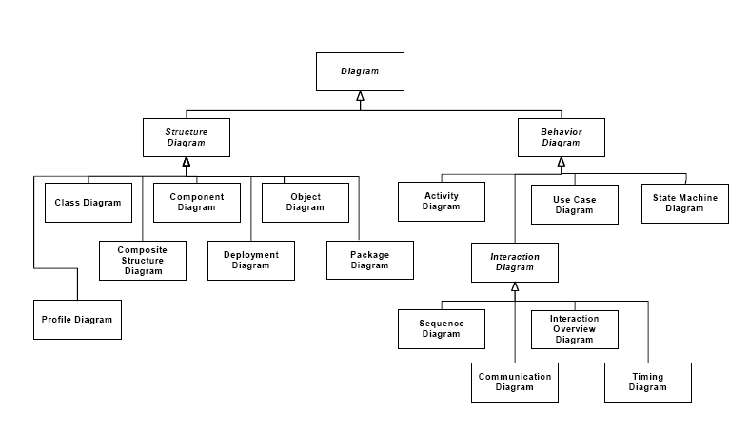
Unified Modeling Language - Introduction

Slide 12
UML - Introduction
Structure Diagrams show:
Static aspects
Time is irrelevant
Components and how are they related
Behavioral Diagrams show:
Dynamic aspects that change over time
Collaborations, flows, states
Components and how they work

Slide 13
UML - Introduction
Model = diagrams + documentation; abstraction of phenomena in the real world (read software system)
Diagrams = structural + behavioral
Structural = static view; objects, attributes, operations, relationships
Behavioral = dynamic view; collaboration, changes in internal states
Interaction diagrams = subset of behavioral; flow control and data
Meta modeling = the construction of a collection of concepts within a certain domain

Slide 14
UML – Use Case Diagram
provides means for specifying required usages of a system.
used to capture the requirements of a system
show what a system is supposed to do.
The key concepts associated with use case diagrams are:
actors
use cases
the Subject = the system under consideration to which the use cases apply.

Slide 15
UML – Use Case Diagram
Actors:
the users of the system AND
any other systems that may interact with the system
obtain an useful result from the system

Slide 16
UML – Use Case Diagram
The required behavior of the subject is specified by one or more use cases, which are defined according to the needs of actors.
Use case:
Specifies the behavior of a part of the system
Description of a set of actions that produce a result that is relevant to an actor
For example: log in, update, view products, etc.
refers to a use case type
an instance of a use case refers to an occurrence of the behavior

Slide 17
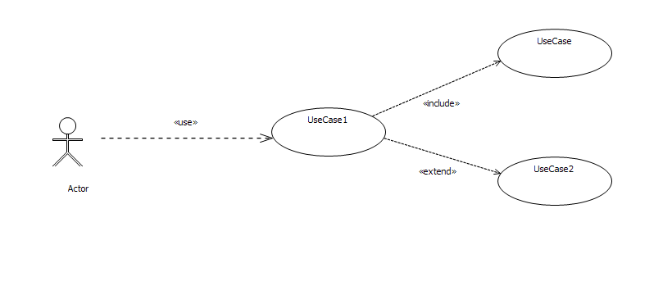
UML – Use Case Diagram
Generic Use Case Diagram - Use case diagram for Room reservation at a hotel

Slide 18
UML – Use Case Diagram
Associations
Communicate association:
Shows the participation of an actor to a use case
Include association
<<include> keyword
Shows that, necessarily, a case of use must include the behavior of another use case
the behavior of the included use case is inserted into the behavior of the including use case
included use case is not optional, and is always required for the including use case to execute correctly

Slide 19
UML – Use Case Diagram
Associations
Extends association
<<extend>>
Optionally, under certain conditions, a case of use must include the behavior of another use case
the behavior of a use case may be extended by the behavior of another use case
extension takes place at one or more specific extension points defined in the extended use case
shows the dependency between the extended and the extending use case
the same extending use case can extend more than one use case
If the condition of the extension is true then the behavior of the extending use case will also be executed

Slide 20
UML – Use Case Diagram
Extension point
a point in the behavior of a use case where that behavior can be extended by the behavior of some other (extending) use case, as specified by an extend relationship.
A condition that is evaluated in the extended use case

Slide 21
UML – Use Case Diagram
Use case scenario
An instance of a use case
Text information on the events and the replies received to produce use case
Specifying a use-case scenario
Requirements-what you need to obtain as a result of use
Restrictions
Basic Conditions
Post - conditions
Invariants
Scenarios – formal descriptions of the sequence of events

Slide 22
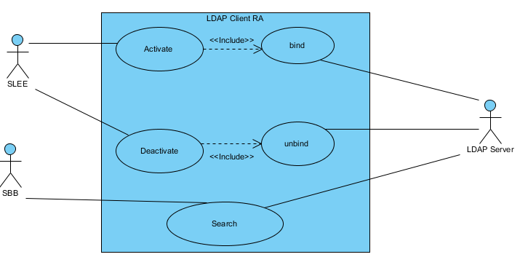
UML – Use Case Diagram – Real Life Example

Slide 23
UML – Use Case Diagram – Real Life Example

Slide 24
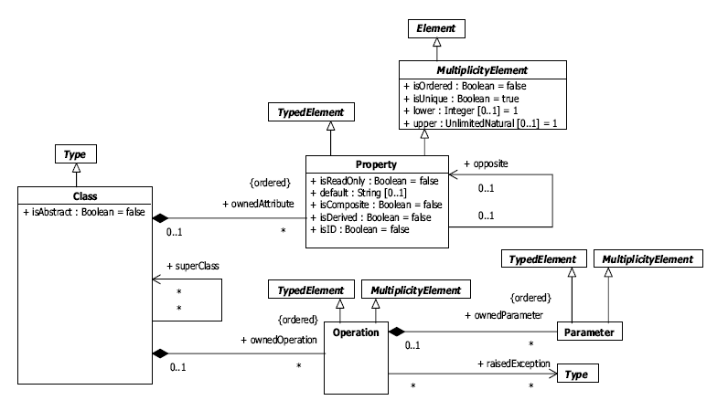
UML – Class Diagram

Slide 25
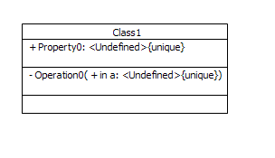
UML – Class Diagram
Elements building up the class diagram (as per UML standard):
Classes
Properties
Operations
Associations
Classes have (as we know from OOP):
Attributes
Operations
participate in inheritance hierarchies
Multiple inheritance is allowed.

Slide 26
UML – Class Diagram
Class characteristics:
The instances of a class are objects
an abstract class cannot have any direct instances
Any direct instance of a concrete class is also an indirect instance of its class’ superclasses.
An object has a slot for each of its class’s direct and inherited attributes.
An object permits the invocation of operations defined in its class and its class’superclasses.
The context of such an invocation is the invoked object.
A class cannot access private features of another class, or protected features on another class that is not its supertype.
When creating and deleting associations, at least one end must allow access to the class.

Slide 27
UML – Class Diagram
Class attributes:
isAbstract : Boolean
ownedAttribute : Property [*] the attributes owned by a class; these do not include the inherited attributes. Attributes are represented by instances of Property. Property is also a construct of UML meta description
ownedOperation : Operation [*] - the operations owned by a class; these do not include the inherited operations.
superClass : Class[*] the immediate superclasses of a class, from which the class inherits.

Slide 28
UML – Class Diagram
Operation:
is owned by a class and may be invoked in the context of objects that are instances of that class.
It is a typed element and a multiplicity element
Operation attributes:
class : Class [0..1] the class that owns the operation.
ownedParameter : Parameter [*] {ordered, composite } the parameters to the operation.
raisedException : Type [*] the exceptions that are declared as possible during an invocation of the operation.

Slide 29
UML – Class Diagram
Operation representation is:
[<visibility>] <name> ‘(‘ [<parameter-list>] ‘)’ [‘:’ [<return-type>] [‘[‘ <multiplicity> ‘]’]
[‘{‘ <oper-property> [‘,’ <oper-property>]* ‘}’]]
where:
<visibility> the visibility of the operation (+public, -private, #protected,~package)
<name> the name of the operation.
<return-type> is the type of the return result parameter if the operation has one defined.
<multiplicity> is the multiplicity of the return type
<oper-property> indicates the properties of the operation

Slide 30
UML – Class Diagram
<oper-property> ::= ‘redefines’ <oper-name> | ‘query’ | ‘ordered’ | ‘unique’ | <oper-constraint>
where:
redefines <oper-name> means that the operation redefines an inherited operation identified by <oper-name>.
query means that the operation does not change the state of the system.
ordered means that the values of the return parameter are ordered.
unique means that the values returned by the parameter have no duplicates.
<oper-constraint> is a constraint that applies to the operation.
<parameter-list> is a list of parameters of the operation in the following format:
<parameter-list> ::= <parameter> [‘,’<parameter>]*

Slide 31
UML – Class Diagram
<parameter> ::= [<direction>] <parameter-name> ‘:’ <type-expression>
[‘[‘<multiplicity>’]’] [‘=’ <default>] [‘{‘ <parm-property> [‘,’ <parm-property>]* ‘}’]
where:
<direction> ::= ‘in’ | ‘out’ | ‘inout’ (defaults to ‘in’ if omitted).
<parameter-name> is the name of the parameter.
<type-expression> is an expression that specifies the type of the parameter.
<multiplicity> is the multiplicity of the parameter
<default> is an expression that defines the value specification for the default value of the parameter.
<parm-property> indicates additional property values that apply to the parameter.

Slide 32
UML – Class Diagram
Operation call concurrency:
Sequential – only one thread executes the operation at a time
Guarded – multiple calls can be made from different threads but only one executes at a time, others are waiting in queue
Concurrent – many calls from different threads can occur simultaneously

Slide 33
UML – Class Diagram
Property
An attribute of a classifier or an association end
Property attributes:
class : Class [0..1] class that owns the property, and of which the property is an attribute.
default : String [0..1] string that is evaluated to give a default value for the attribute when an object of the owning class is instantiated.
isComposite : Boolean - If isComposite is true, the object containing the attribute is a container for the object or value contained in the attribute. The default value is false.
isDerived : Boolean - If isDerived is true, the value of the attribute is derived from information elsewhere. The default value is false.
isReadOnly : Boolean - If isReadOnly is true, the attribute may not be written to after initialization. The default value is false.
isID : Boolean - True indicates this property can be used to uniquely identify an instance of the containing Class. Default value is false.

Slide 34
UML – Class Diagram
The properties and the operations inherit the feature property isStatic:
true – scope at classifier level
false – scope at instance level

Slide 35
UML – Class Diagram
Properties representation is, in a shorter form:
[visibility][multiplicity][:type][=default value][(properties)]

Slide 36
UML – Class Diagram
Associations between classes: - onnections between classes
Association characteristics:
name of the association:
verb denoting an action
example: contains, uses, holds
multiplicity - the number of instances of a class that can be related to an instance of the other class in the association
type, given by the number of participating classes:
unary
binary
ternary
role
a label for the class inside the association
what the class signifies
a class with more than one association can play different roles to each of the classes it is associated to
aggregation
shared – the shared aggregation end classifier is needed in order to perform an action but can be shared
composite – the composite end classifier is part of the classifier

Slide 37
UML – Class Diagram
An association with one end marked by a navigability arrow means that:
the association is navigable in the direction of that end
the marked association end is owned by the classifier
the opposite (unmarked) association end is owned by the association.

Slide 38
UML – Class Diagram
An association with neither end marked by navigability arrows means that:
the association is navigable in both directions,
each association end is owned by the classifier at the opposite end (i.e., neither end is owned by the association).

Slide 39
UML – Class Diagram
If no multiplicity is shown on an association end, it implies a multiplicity of exactly 1.
If an association end is unlabeled, the default name for that end is the name of the class to which the end is attached,with the first letter is a lowercase letter.

Slide 40
UML – Class Diagram
Associations that are not explicitly named, are given names that are constructed according to the following production rule:
“A_” <association-end-name1> “_” <association-end-name2>
where <association-end-name1> is the name of the first association end and <association-end-name2> is the name of the second association end.

Slide 41
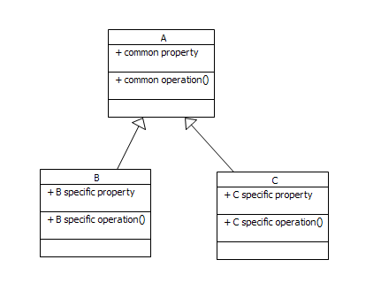
UML – Class Diagram
Generalization:
Relationship between general and specific classifiers
Extraction of common properties and operations from multiple classes and their isolation in superclasses
A<-B<-C is transitive; C “is an” A

Slide 42
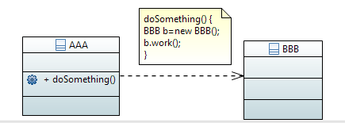
UML – Class Diagram
Dependency
Relationship showing that an element (class but not restricted to) requires another element in order to:
Be defined
Implement a certain behavior
Mostly having the “ use “ meaning

Slide 43
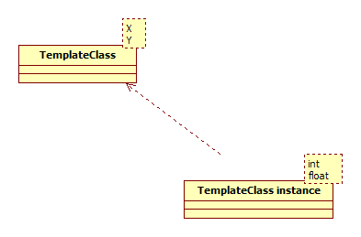
UML – Class Diagram
Template classes
An instance of a template class is a concrete class.

Slide 44
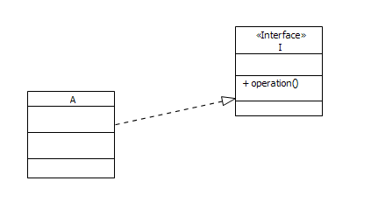
UML – Class Diagram
Interfaces:
set that groups together operations defining a service of a component (class)
Do not have attributes

Slide 45
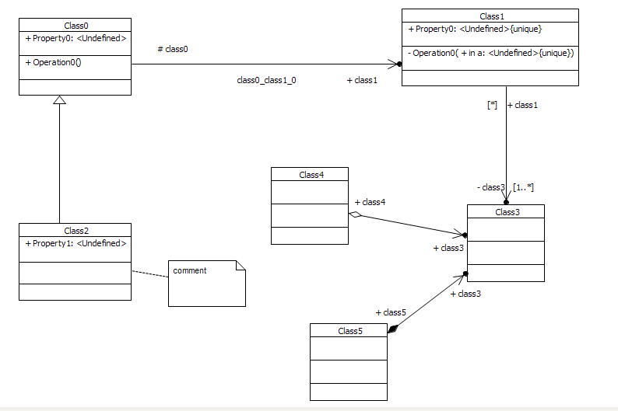
UML – Class Diagram

Slide 46
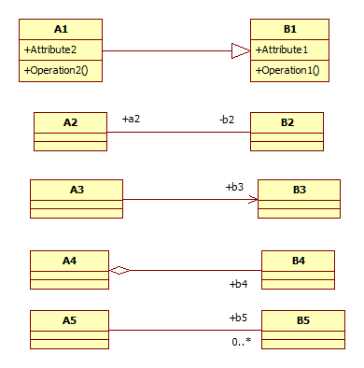
UML – Class Diagram – Mapping to Java Classes
public class A1 extends B1 {
public Object Attribute2;
public void Operation2() {
}
}
public class B1 {
public Object Attribute1;
public void Operation1() {
}
}
public class A2 {
private B2 b2;
}
public class B2 {
public A2 a2;
}
public class A3 {
public B3 b3;
}
public class B3 {
}
public class B4 {
}
public class A5 {
public B5[] b5;
}
public class B5 {
public A5 a5;
}

Slide 47
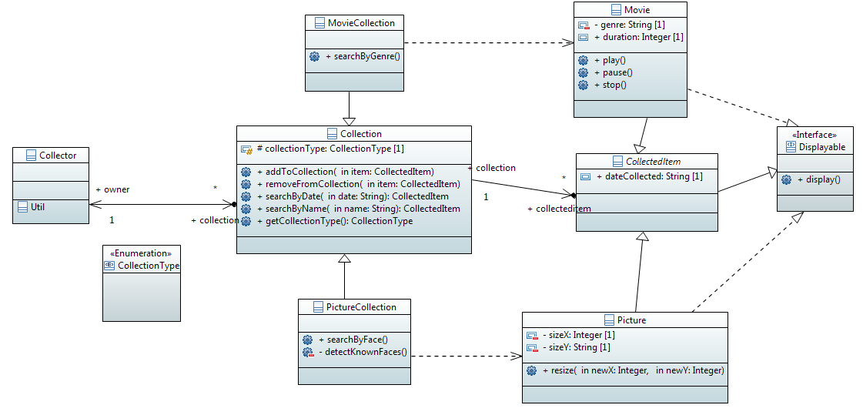
UML – Class Diagram

Slide 48
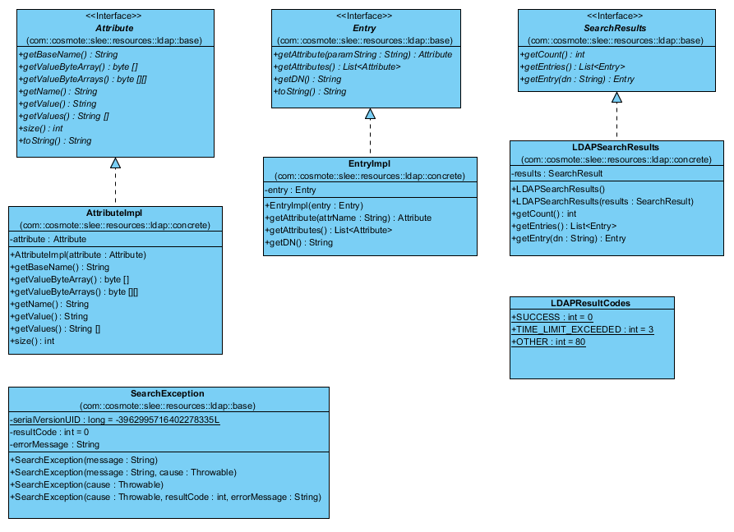
UML – Class Diagram

Slide 49
UML – Object Diagram
Keep the instances of the elements contained in the class diagrams
Represents a snapshot of the system at a time
Classes define the full semantics of abstractions
helps the understanding of the relationship between classes and validation of the model

Slide 50
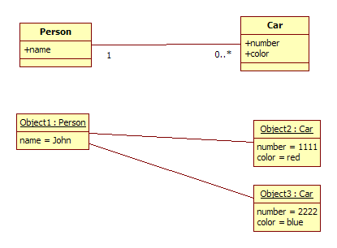
UML – Object Diagram

Slide 51
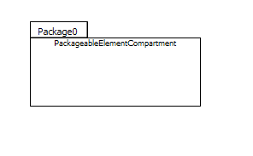
UML – Package Diagram
In order to simplify complex diagrams, you can group classes in packages.

Slide 52
UML – Package Diagram
Package:
A collection of elements in UML related from logical point of view
Groups: classes, interfaces, components, nodes, use cases, the other packages
It is recommended that a hierarchy on a small number of levels
You can control the visibility of elements by attributes at package level

Slide 53
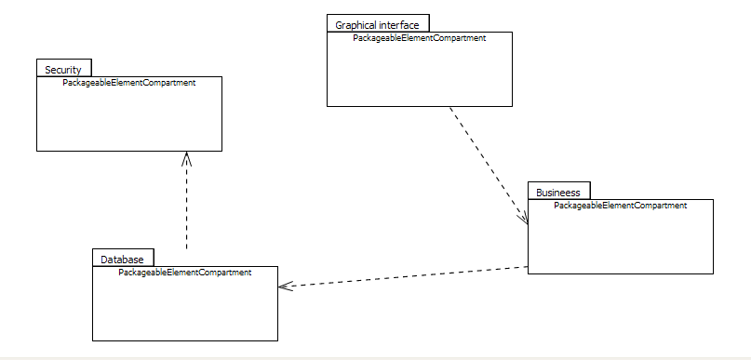
UML – Package Diagram
Relationships between packages:
Dependencies – elements from one package are used by elements from other package
Generalization - Specialized packages inherit public and protected elements from the more general package

Slide 54
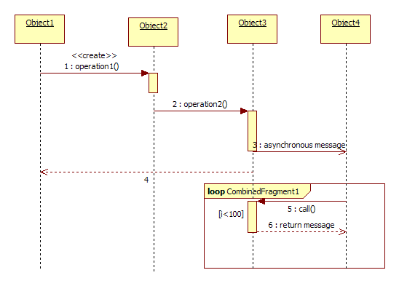
UML – Sequence Diagram
Describes the interaction between objects, ordered in time
Graphical representation of scenarios use cases

Slide 55
UML – Sequence Diagram
Object lifeline - Shows how long an object exists
Some objects may be destroyed during the interaction
Control points – Rectangles that indicates the period of time as the subject does an action

Slide 56
UML – Sequence Diagram
Lifeline:
Represents an instance of the classifier involved in the interaction
Object name : class name
Object name can be omitted – anonymous
Gates:
entry or exit points for messages going in or out the modeled interaction
Types of messages:
Synchronous calls
Asynchronous calls
Messages for object creation/deletion
Returns

Slide 57
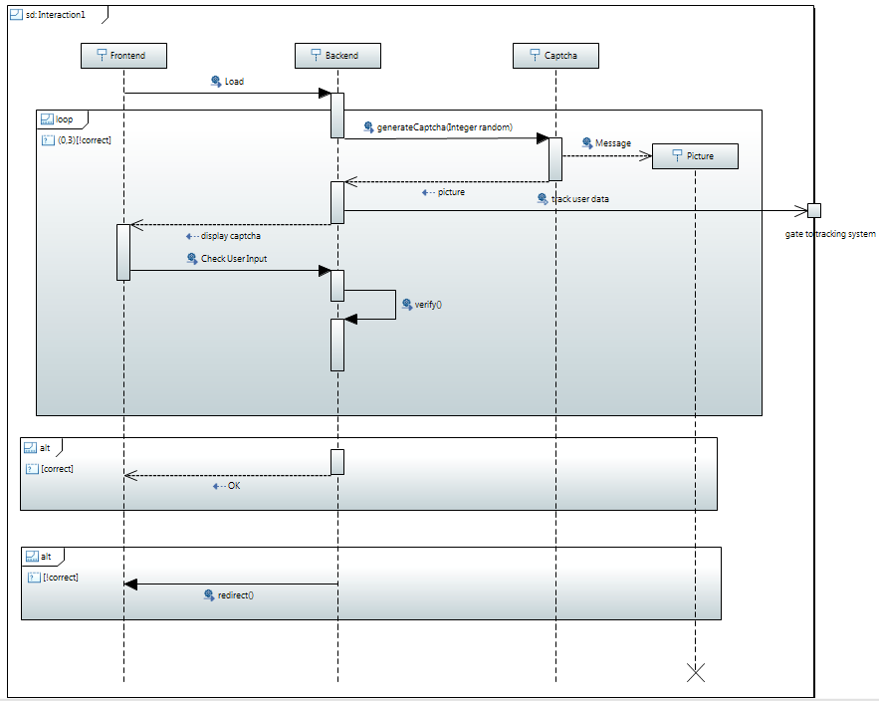
UML – Sequence Diagram
Combined fragments:
Contain conditional structures that affect the flow of messages

Slide 58
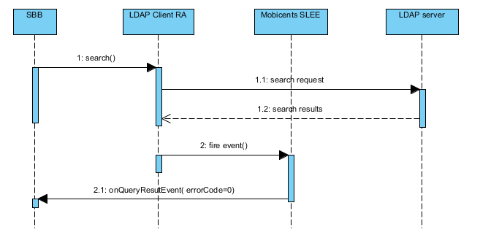
UML – Sequence Diagram - Example

Slide 59
UML – Communication Diagram
Collaboration diagrams/Communication diagrams
contain the same information as sequence diag.
focuses on the roles of objects and not when they interact
graph with nodes-objects and edges-messages

Slide 60
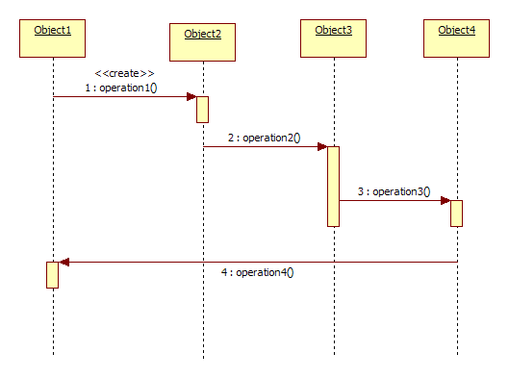
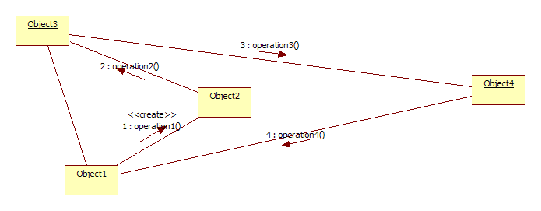
UML – Communication Diagram
a collaboration diagram is easily obtained from the corresponding sequence diagram

Slide 61
UML – State Machine Diagram
UML 2.4+ introduces State Machine Diagram, previously being State Diagram
State Machine Diagram
Describes the behavior of a modeled system/system part/component as a series of states
shows the status and the events that produce the changing status of an object
a graph made up of nodes and edges
a state machine is owned by a context; the context supports the triggers and operations available for state machine activities

Slide 62
UML – State Machine Diagram
Types:
Behavioral State Machines:
describes the behavior of a modeled element in terms of states
Protocol State Machines:
a specialization of behavioral state machines
dedicated to showing how should a classifier be used throughout its lifecycle
what operations can be called in which state (usage protocol)

Slide 63
UML – State Machine Diagram
Nodes and edges:
State
a condition or situation in the life of an object when it meets certain conditions, carries out certain tasks or wait for certain events
Behavioral State:
Name
Internal activities: Actions carried out at the entrance/exit of a State, or do – throughout the state
Internal transitions – does not change the status of ob.
disjoint or competing substates
Deferred events – list of candidate triggers; if the current state is not able to handle the event yet, it is postponed, until a state is able to handle it
Protocol State:
Name
Don’t have: entry, exit, do activity
May have: submachine states, composites

Slide 64
UML – State Machine Diagram
Composite State:
Nested states that can be:
A list of sequential states
Concurrent states (orthogonal) – mutually exclusive
Grouped in regions
Initial state
Pseudo state associated with the creation of the state machine
Single transitions to the first default state
Final state
State machine finished execution
State machine is terminated (objects destroyed)

Slide 65
UML – State Machine Diagram
Choice
Branch based on condition
Evaluates the guards of the outgoing triggers and chooses which should be fired
Fork
Split a transition into more transitions
The branches are executed concurrently
Join
Merges parallel state machine executions when concurrent regions trigger specified events

Slide 66
UML – State Machine Diagram
Transition –
Edge showing movement of an object from a source state to a destination state
Elements of a behavioral transition
Source State
trigger event: signals, calls, the passage of time, without shutter (implicates)
guard: Boolean expression that is evaluated
behavior expression – action/atomic operation acting on the object or other objects visible (operation calls, creating/destroying items, sending a signal) executed on transition
Destination state
Protocol transition:
Associated with operation call in the context that depends on current state
Pre-condition
Trigger
Post-condition

Slide 67
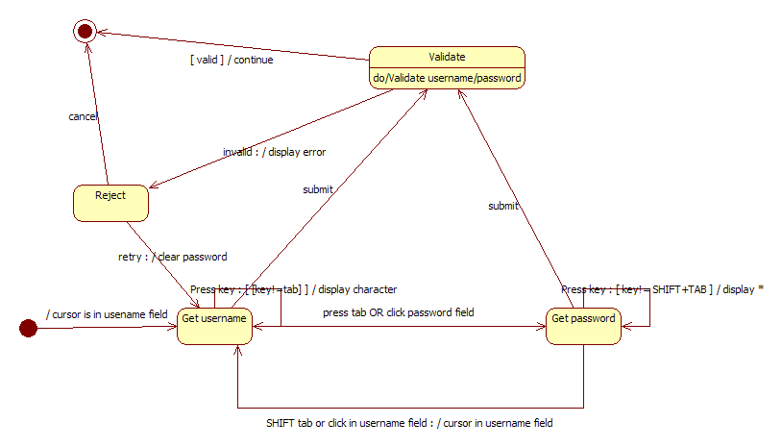
UML – State Machine Diagram

Slide 68
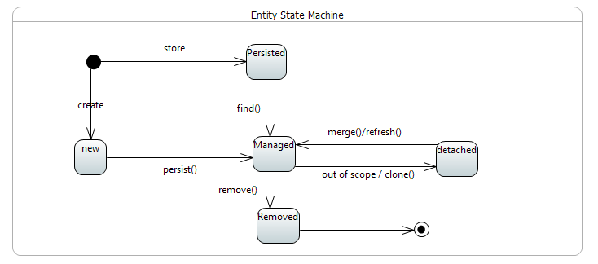
UML – State Machine Diagram
Protocol State Machine

Slide 69
UML State Machine Diagram
Real life example

Slide 70
UML – Activity Diagram
Activity diagram:
Describes behavior in term of flow of actions
Flowchart like
Shows control flows

Slide 71
UML – Activity Diagram
Activity diagram elements:
Activity partitions:
Swimlanes for each classifier
group activities under the responsibility of the classifier
Actions produced a single transition to the next action
Control flow
Transition from an action to another
A transition can branch out into 2 or more mutually exclusive transitions
Fork - an alternative way of Boolean condition-based
Join – when there are competing streams join
Decision nodes

Slide 72
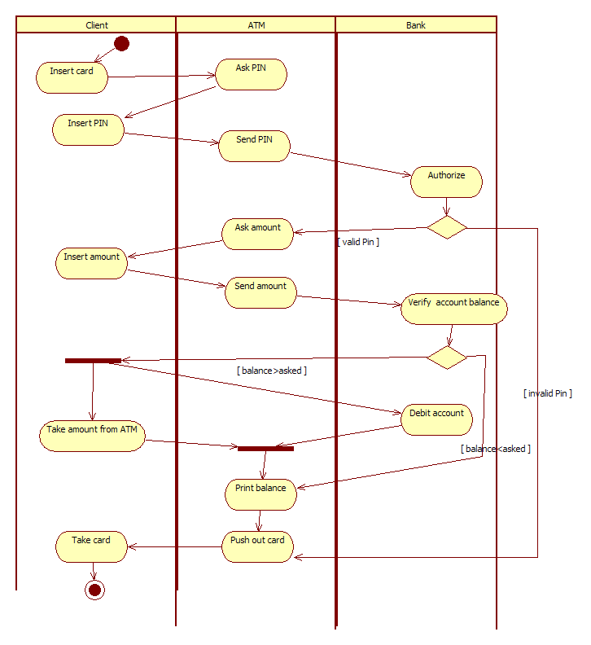
UML – Activity Diagram

Slide 73
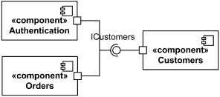
UML – Components Diagram
Components diagram
Describes system components and their relationship.
Shows how the components connect with each other via interfaces

Slide 74
UML – Components Diagram
Elements:
Components
Physical or logical components of the system
Components are classifiers therefore static description applies to them: attributes, operations, dependencies, etc.
Ports
A communication gateway with other components
Connectors
Show strong coupling between connected elements
Parts
Reusable elements
Interfaces
Provided
Required
Another implementation exposing or consuming the interface may replace the existing one

Slide 75
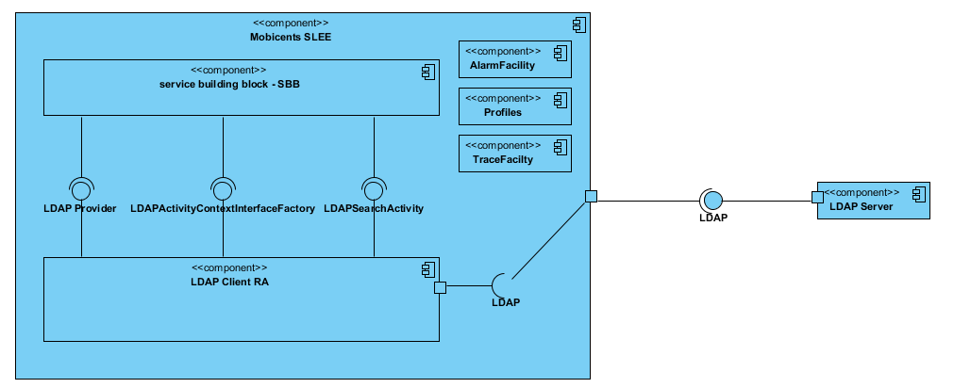
UML – Components Diagram

Slide 76
UML - Deployment Diagram
Shows static aspects related to the deployment of artifacts on nodes.
Node (device):
Hardware: physical server
Execution environment
Software: e.g. JBoss container
Artifact:
Output of the development process
Binary packages, configuration files, etc.
Manifestation of components (e.g. log, statistics etc.)

Slide 77
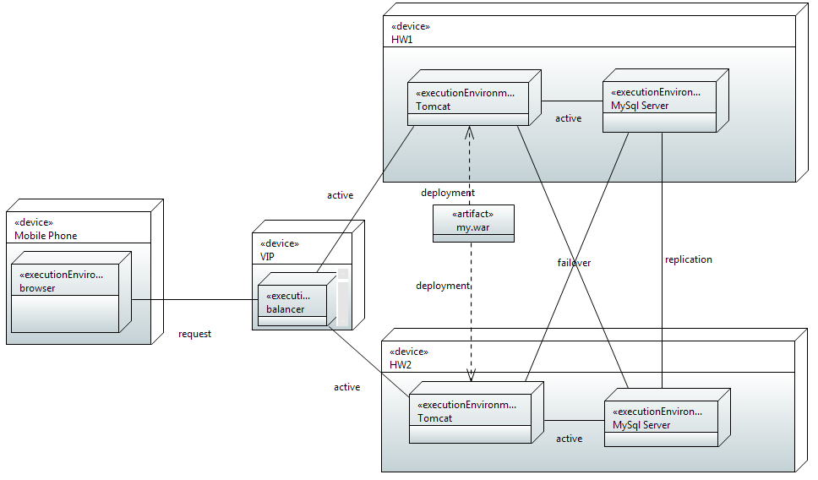
UML - Deployment Diagram

Slide 78
UML – Composite Structure Diagram
Shows
whole – part relationship between classifiers
internal structure
collaborations between elements
Contains
Classes
Collaborations
Connectors
Ports

Slide 79
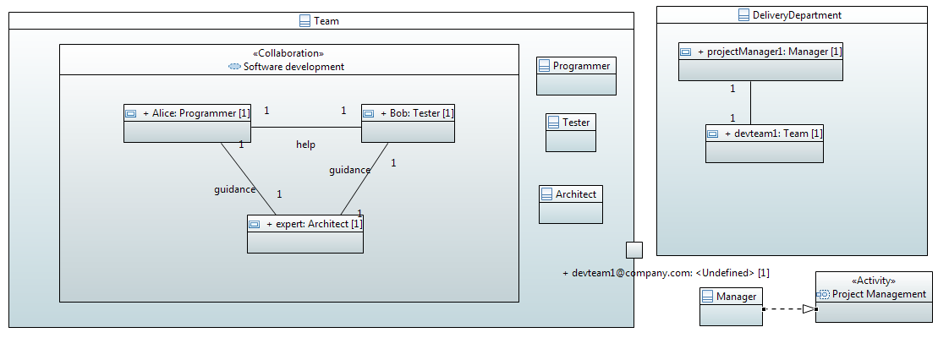
UML – Composite Structure Diagram

